Slide 1
Pb Siddhartha college of arts & science
Information technology assignment
Topic: Application deployment using SCCM
Done by:
Name: T . Vasundhara
Rno : 214223p
B.Sc. CSCS(2nd year)

Slide 2
AN APPLICATION
An application also referred to as an application program or application software, is a computer software package that performs a specific function directly for an end user.

Slide 3


Makes sure that the app is being used in a proper way.
Creates the most system and application level standards.
Manages and oversees the use &control of SCCM application.
Techsupport & troubleshooting.
Application administrator

Slide 4
creation
STAGES OF AN APPLICATION
DEPLOYMENT
MONITORING

Slide 5
Creation of applications using SCCM
Creation
of applications
Automatic
Manual
Automatically detects the deployment type
specifying the deployment type manually

Slide 6
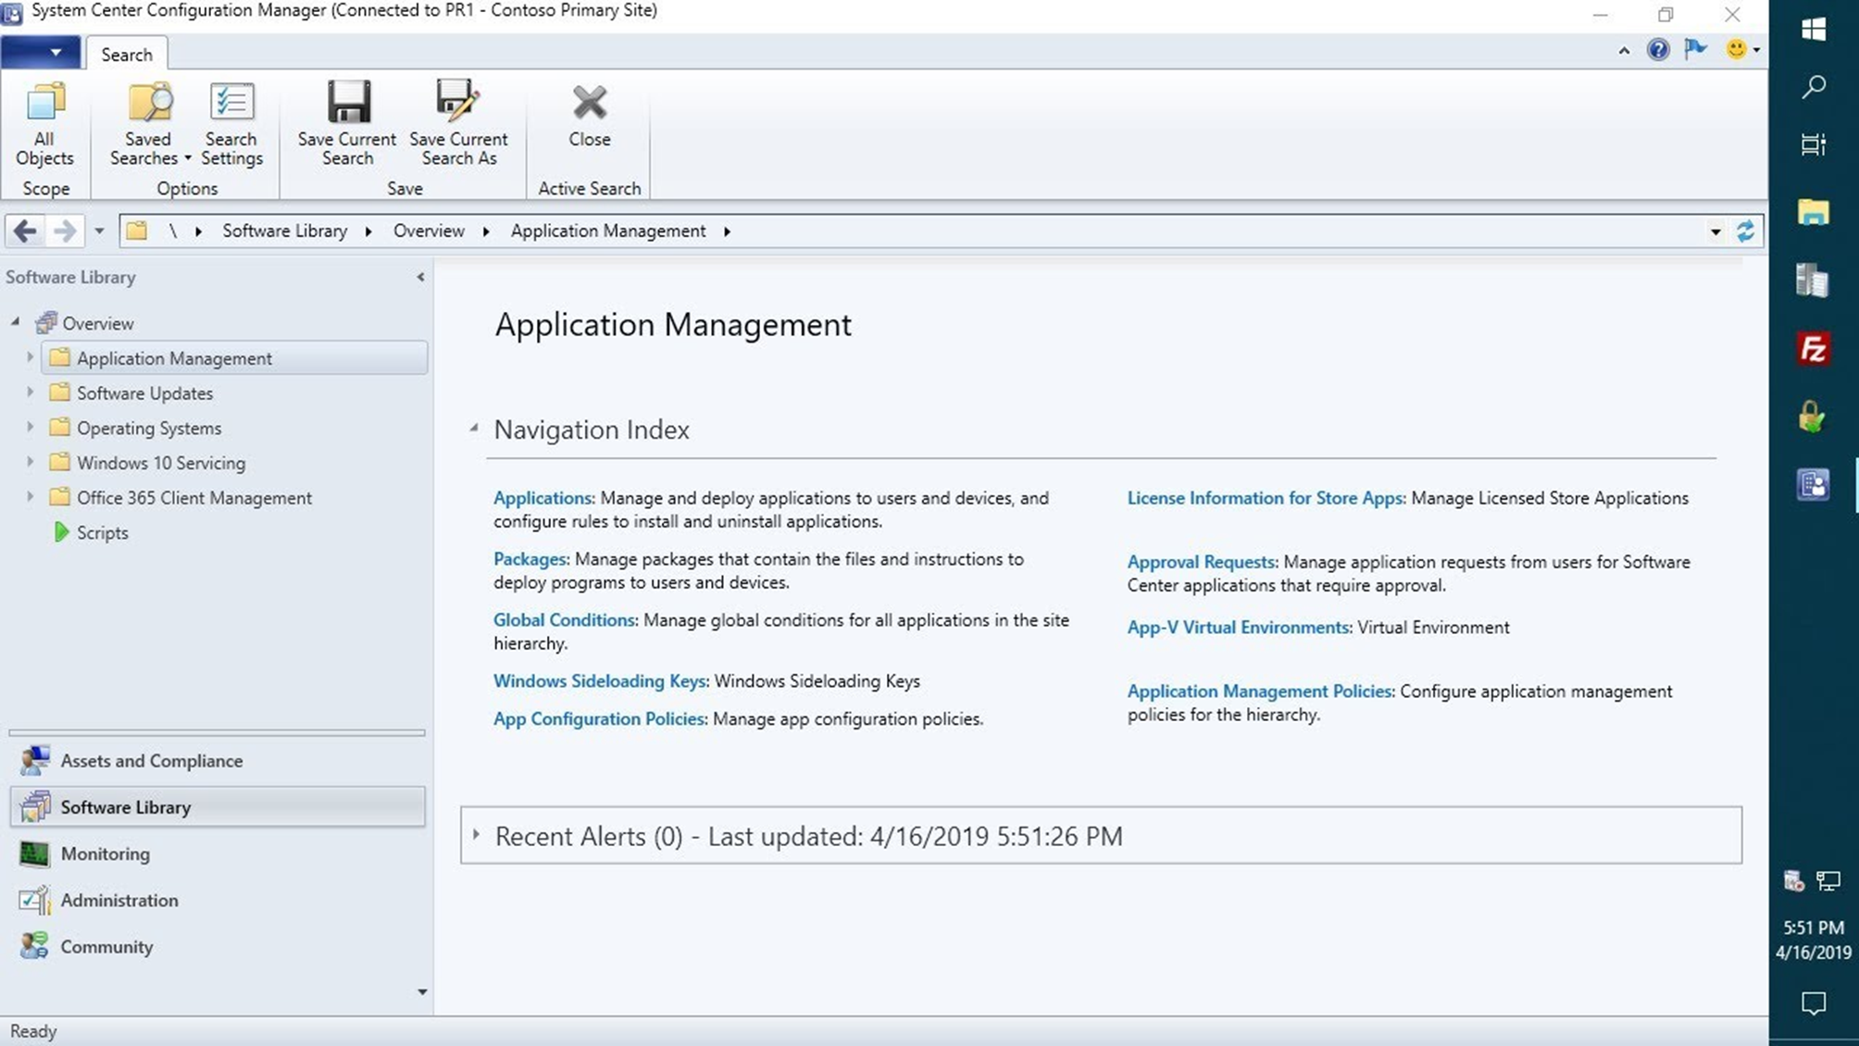



STEPS TO CREATE AN APPLICATION
In the cm console$→$go to ‘software library’ workspace $→$application management.

Slide 7
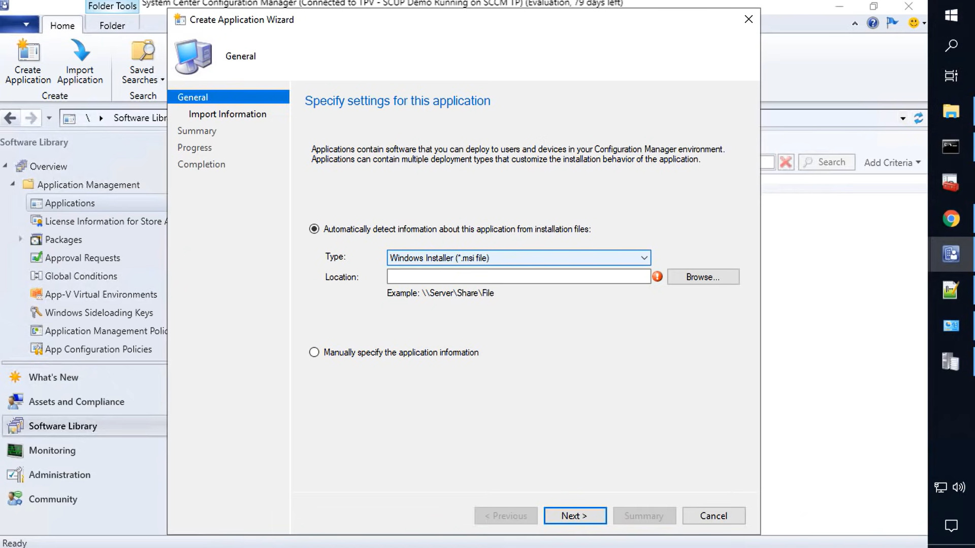
2. Select the type of creation: AUTOMATIC or MANUAL

Slide 8


Automatic detection
on the general page$→automatically detect$
Info.
In the ‘TYPE’ dropdown list select the app file.
In the ‘location’ box, specify the app installation file.
Choose next—review the summary---finish
On the ‘general information page’—specify the info like name , admin comments etc
On the ‘information import ‘page –review the info—click on next.

Slide 9

MANUAL DETECTION
On the ‘general’ page—select manually specify the app info--next
Specify the ‘general information’ like name , admin comments etc.
On the ‘software center’—create app wizard—specify the info like language ,local app name , user categories , etc.
Choose ‘next’ –review the summary information.
On the ‘deployment types’ page –click on ‘ADD’ to create a depl type.

Slide 10
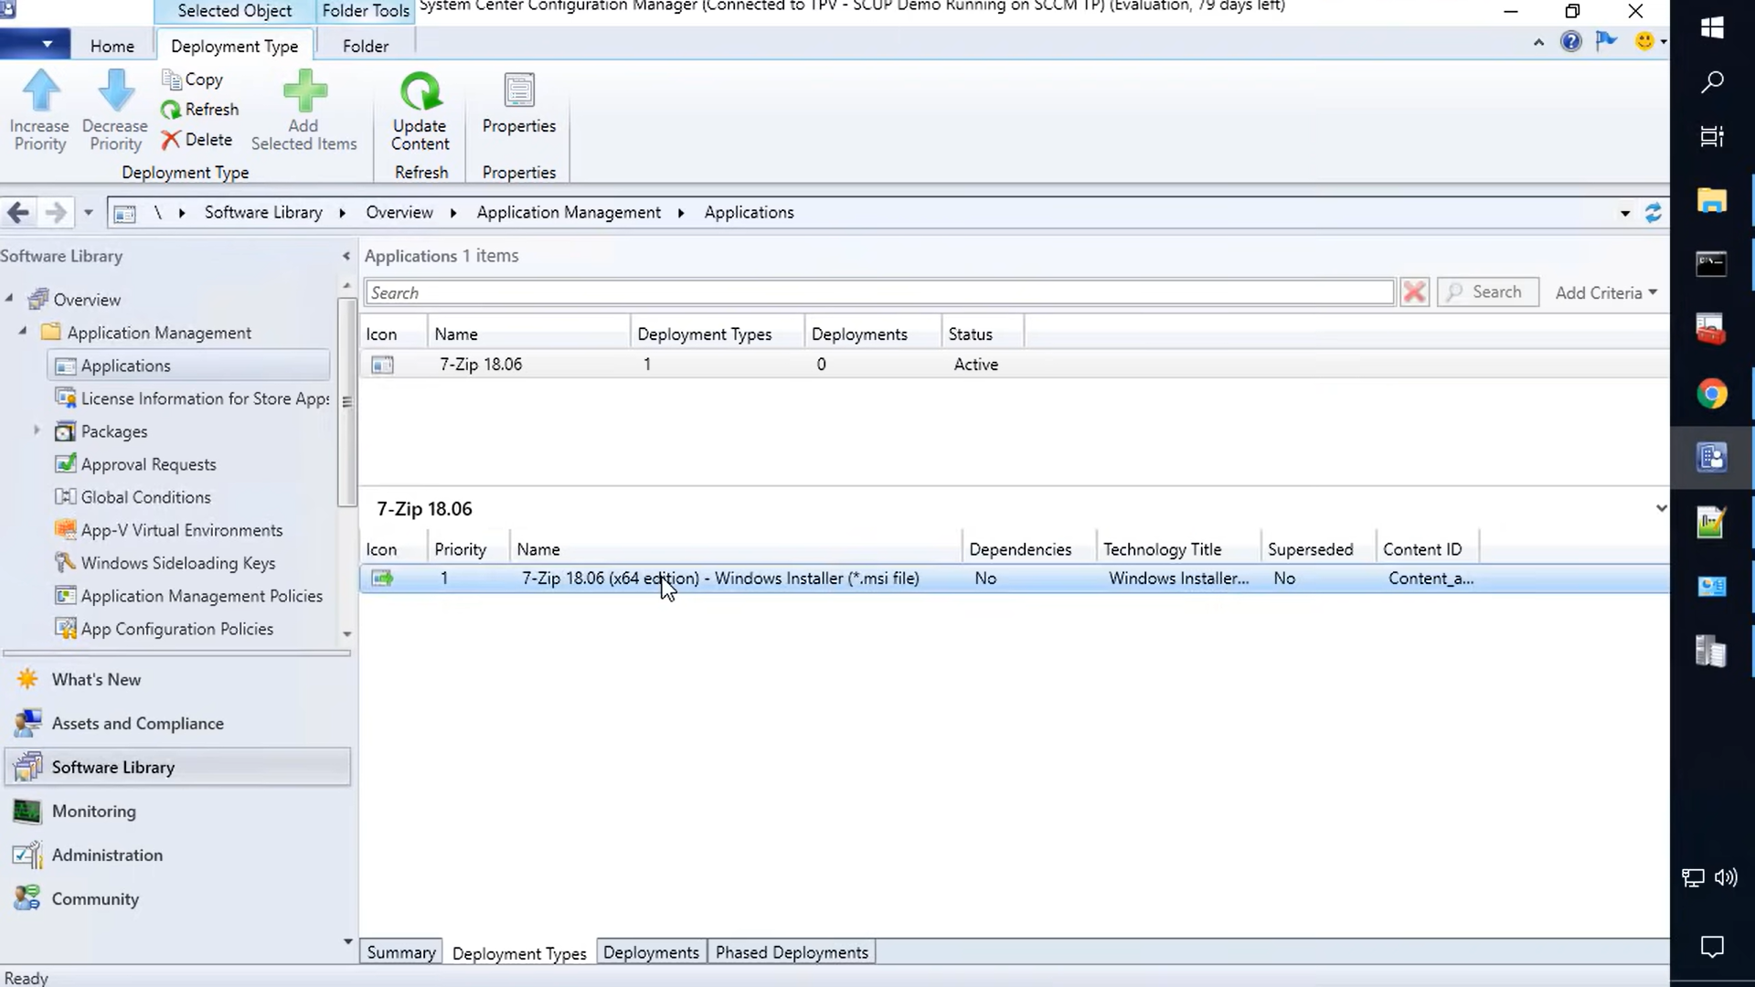

Slide 11
DEPLOYMENT OF APPLICATION
“Application deployment “ AKA software deployment is the process of installing , configuring , updating , and enabling one application that make a software system available for use.

Slide 12
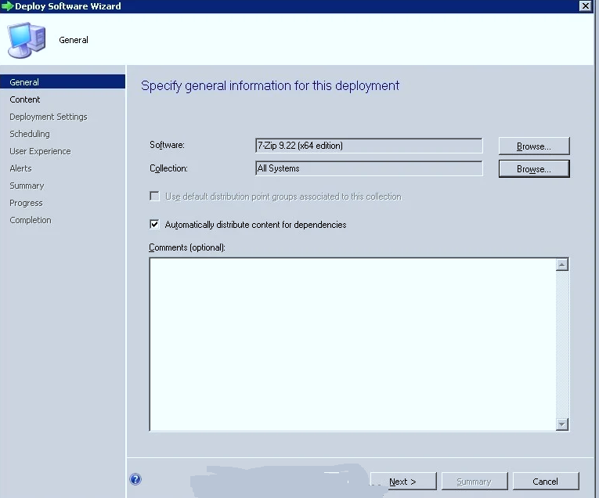
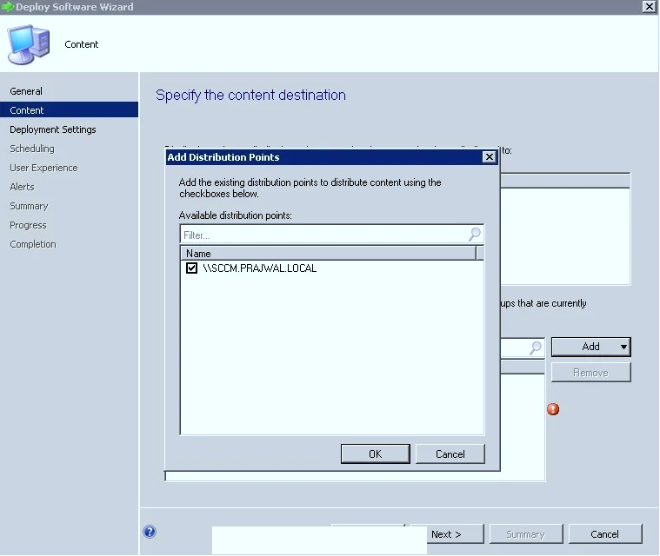
Steps to deploy an application
In the CM console—go to ‘software library’ workspace—expand ‘application management’—select either ‘application’ or ‘application group’.
1
2

Slide 13
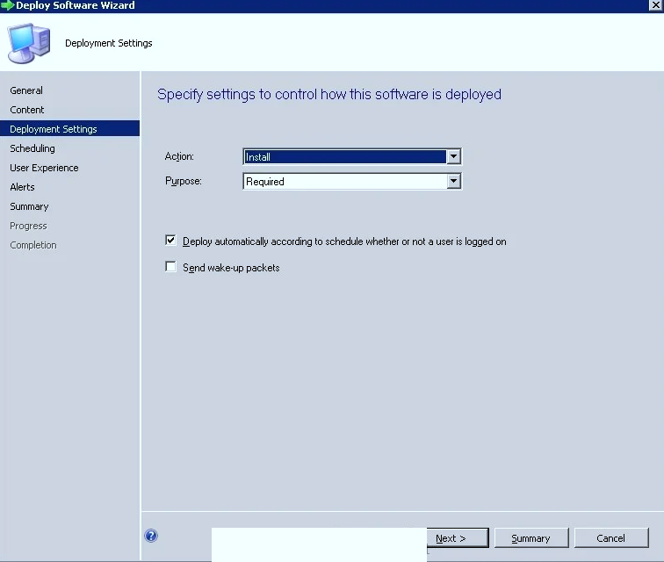
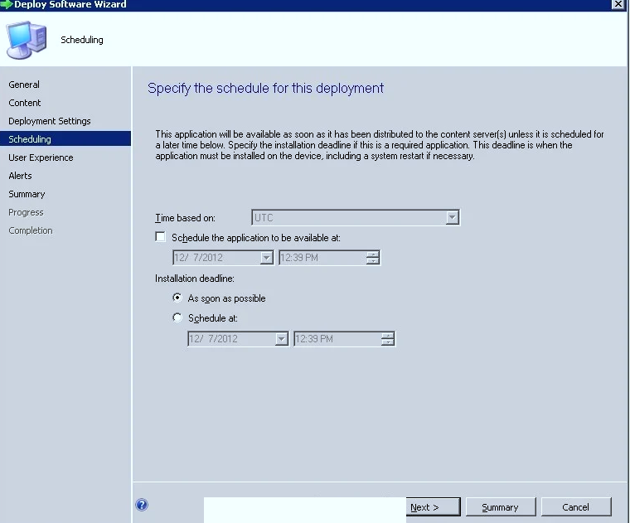
3
4

Slide 14
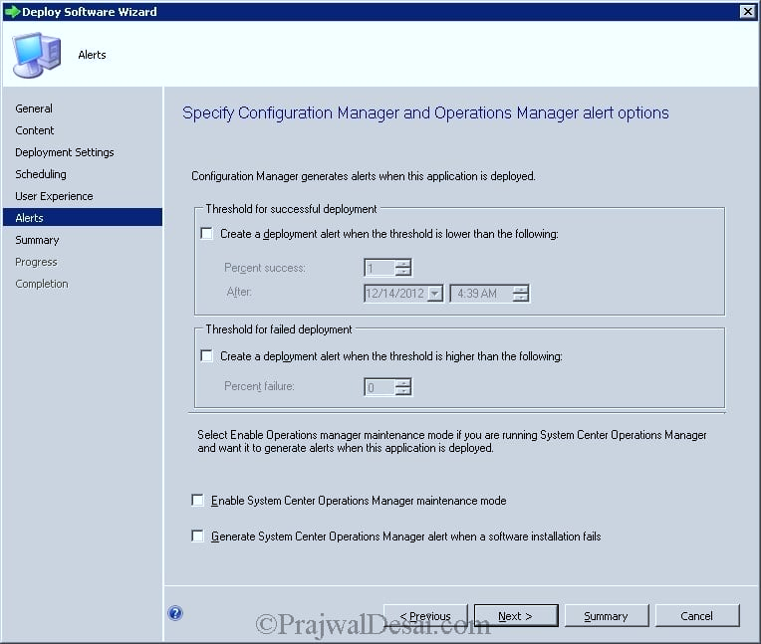
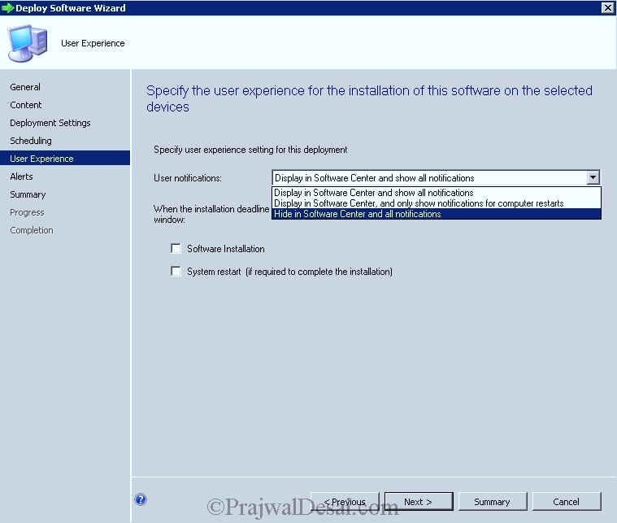

5
6

Slide 15
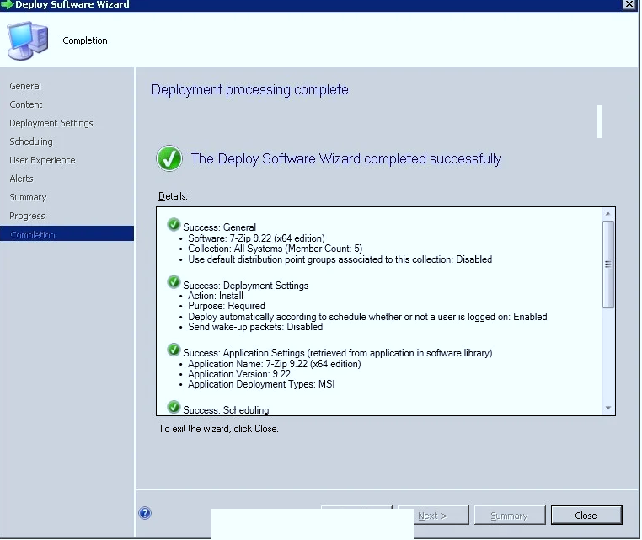
7

Slide 16
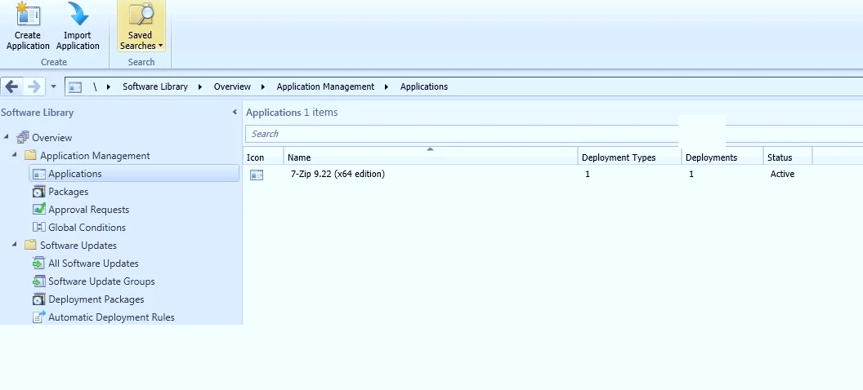


Window after the deployment is done.

Slide 17
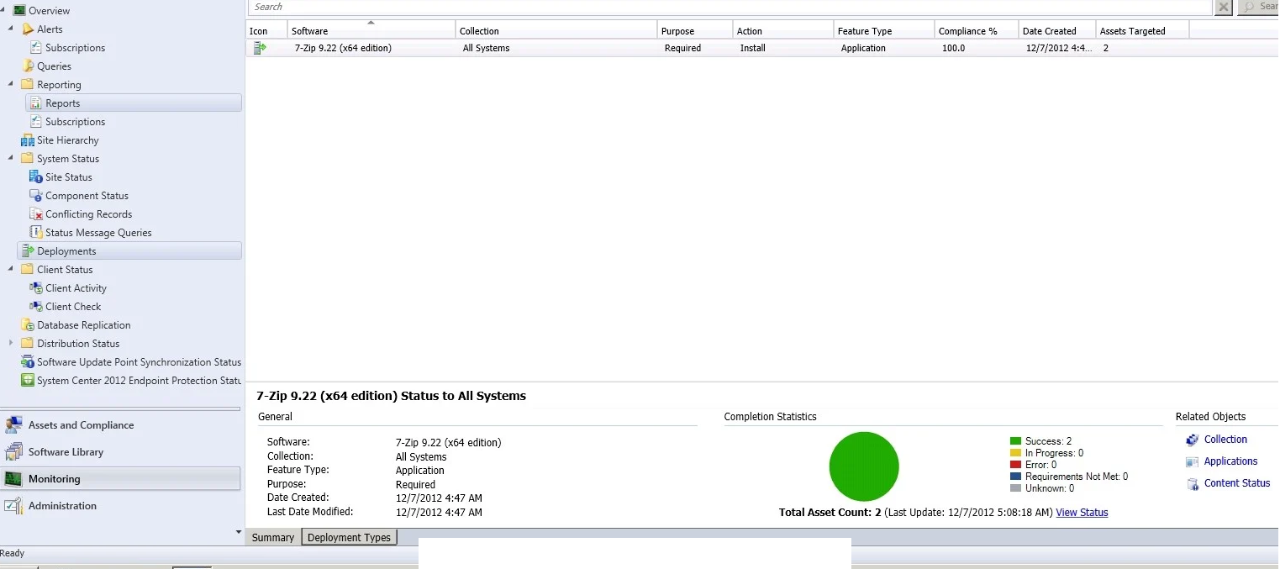
MONITORING THE APPLICATION

Slide 18

THANK YOU

